Slide 1
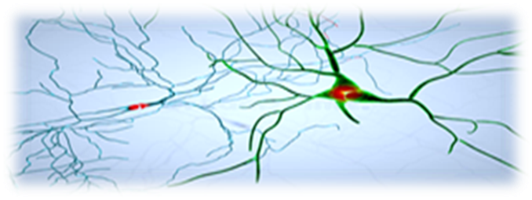
Understanding
Acquired Brain Injuries
Notes:
MATRIX Neurological is a lived experience led registered charity founded over 10 years ago
to provide recovery support to children and young people who have sustained an acquired brain injury as the result of an accident or illness; and provide peer support to their families.
7 years ago, we started delivering cognitive stimulation interventions that has delivered significant improvements for children and young people.

Slide 2
What is an Acquired Brain Injury? (ABI)
Brain damage caused by events (post birth) to a ‘NORMAL’ brain
(i.e. that which is assumed to have the potential for normal development rather than as part of a birth complication, genetic or congenital disorder)
(Source: Paediatrician Neuro-disability)
It not a mental health condition.
It is not Autism or ADHD!
Notes:
Acquired brain injuries do NOT cause Autism or ADHD. Both Autism and ADHD are genetic conditions and usually run in families.
FASD affects the normal development of the brain within the womb, so pre-birth. FASD is therefore not an ABI.

Slide 3
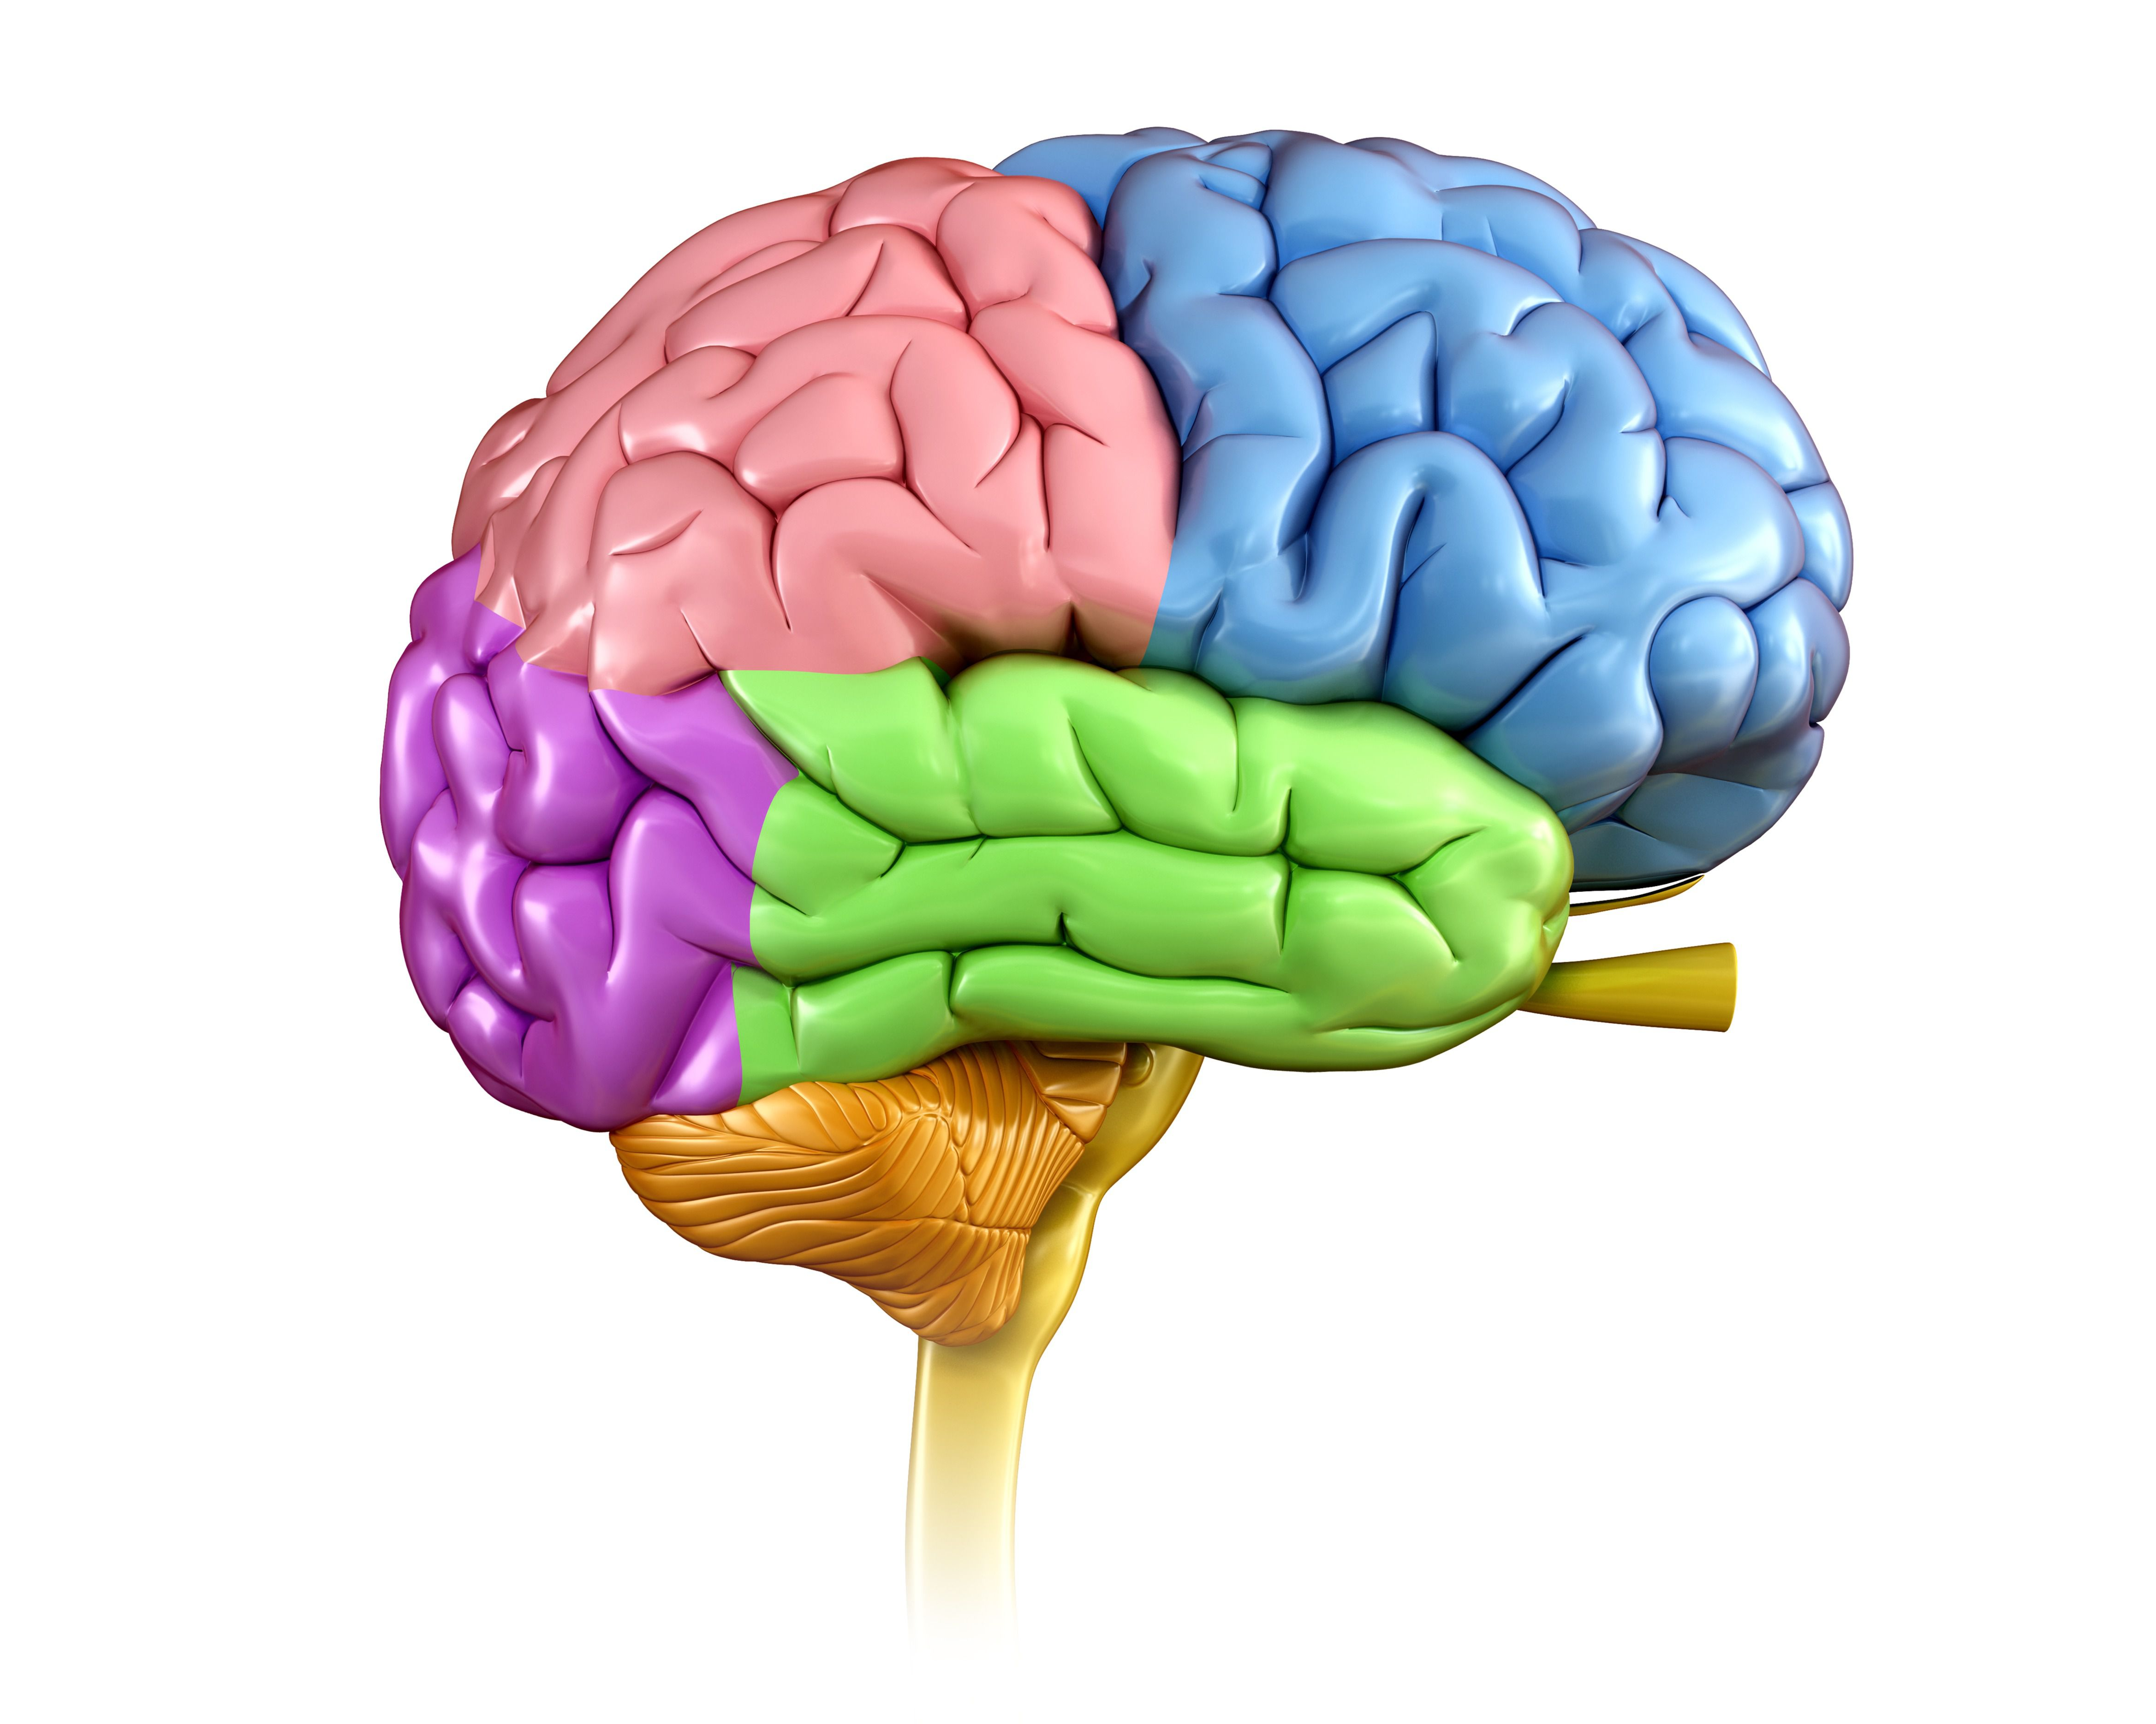
The Human Brain Different lobes are responsible for different functions that work inter-dependently
Parietal Lobe
Knowing right from left
Sensation
Reading
Body orientation
Frontal Lobe
Problem solving
Emotional traits
Reasoning (judgement)
Speaking
Voluntary motor activity
Occipital Lobe
Vision
Colour Perception
Temporal Lobe
Understanding language
Behaviour
Memory
Hearing
Cerebellum
Balance
Coordination & control of voluntary movement
Fine muscle control
Brain Stem
Breathing
Body temperature
Digestion
Alertness / sleep
Swallowing
Notes:
* Has 100,000 miles of blood vessels.
100 billion neurons each with up to 15,000 connections
A human brain is not fully developed until the age of 25.
It’s a complex organ and how it functions is little understood.

Slide 4
How are Acquired Brain Injuries Caused?
Type 1
Traumatic Brain Injury (TBI)
Type 2
Non-Traumatic Brain Injury (N-TBI)
Causes:
Falls & Trips (1 metre)
Road Traffic Accidents
Concussion
Extreme Sports
Cycling Accidents
High Velocity Impacts
(i.e. Golf Ball)
Sporting Head Injuries
Assault
Being dropped (toddlers and infants)
Causes:
Stroke
Meningitis
Encephalitis
Hydrocephalus
Brain Haemorrhage
Brain Tumour
Cardiac Arrest
Drowning/Nr drowning
Strangulation
Suffocation
Poisoning/Sepsis
Chemotherapy Treatment
Covid 19
Notes:
Two types – Traumatic Brain Injury (TBI) or Non-Traumatic Brain Injury (N-TBI or A-Traumatic).
TBI’s are the most common.
Acquired brain injuries (both types) are the biggest cause of death and disability in the UK; yet the least recognised, least understood and least supported disability.
Public Health Data estimates that 50% of all 4-year-olds will already have an undiagnosed TBI!
Lifetime costs to the state are up to £4.9m per child in unemployment benefits, social care and welfare support.
Appropriate interventions can bring about significant savings to the public purse.

Slide 5
What does a TBI look like with SPECT imaging? Source: Dr D Amen TED Talks
Traumatic Brain Injury (TBI) with SPECT Imaging
Notes:
SPECT Imaging appears to provide the clearest evidence of the severity and impact of an acquired brain injury on the brain.
CT scans miss 65% of TBI’s and MRI Scans miss up to 70% which are provided by the NHS.
This leaves thousands of people struggling with an undiagnosed traumatic brain injury.

Slide 6
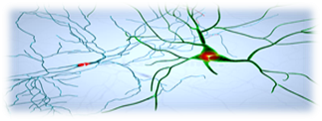
Prevalence of Neuro-disability in the general CYP population
Source: McKinley et al, 2008; McGuire et al, 1998. – “Nobody made the connection” Report for Children’s commissioner October 2012 & Neuro Rehab Times
Notes:
The Children’s Commissioner’s report highlighted the true reported prevalence of neuro-disability in children and young people and the neglect they face in this country. Nothing has changed in over 12 years!
Children and young people who have sustained acquired brain injuries, are being mis-diagnosed with Autism or ADHD.

Slide 7
Deficits Caused by an Acquired Brain Injury
(KNOWN) DEFICITS OF AN ACQUIRED BRAIN INJURY
PHYSICAL & SENSORY | COMMUNICATION | COGNITIVE | BEHAVIOURAL EMOTIONAL
Motor Deficits: Paralysis Abnormal Muscle Tone Ataxia (co-ordination) * Dysphagia Sensory Deficits: * Vision Hearing Loss Smell / Taste Touch/Tactile Proprioception Vestibular/Balance Interoception Dysphagia (swallowing difficulties) Seizures Other: Headache Fatigue Pain Sleep Limbic System | Language Deficits: Expression (finding the right words) Comprehension (understanding) Dysarthria (difficulty speaking) Dyslexia (difficulty reading) Dysgraphia (inability to write) Dyscalculia (inability to do maths) | Impairment of: Memory Attention Perception Problem Solving Insight Safety Awareness / Risk Taking Self-Monitoring Social Judgement | Deficits: Emotional Liability (unstable emotions or emotional over-reaction) Poor Initiation Mood Change Adjustment Problems Aggressive Outbursts Disinhibition Poor Motivation Inappropriate Sexual Behaviour Psychosis OCD Mental Health Issues
(British Society Rehabilitation Medication & Royal College Physicians 2003)
Notes:
The first TBI was diagnosed 150 years ago, when neuroscience became a specialist field in acquired brain injuries.
Traumatic brain injuries can be classified as mild, moderate or severe, but the impacts can be life-changing but across all.
A person can be affected in one domain, have a small number of issues across all domains or have a wide range across all domains.
Injury to a child’s developing brain has far reaching effects
Cognitive impairment may be masked in primary school and only become apparent in teenage years
It is therefore essential that people receive early restorative neuro-rehabilitation interventions.

Slide 8
Recovery potential & lost opportunities!
Neuroplasticity
The brain’s ability to reorganize itself by forming new neural connections
throughout life with stimulation.
Neuroplasticity allows neurons to compensate for injury by REWIRING around damaged parts.
Best treatment is
COGNITIVE STIMULATION!
The poorer the socio-economic resources
MEANS
Poorer l-t outcomes
Increased social problems
Vulnerable populations
Strategies and/or medication do not deliver improvements.
Misdiagnosis leaves brain injured people unnecessarily disabled.
Notes:
There exists a two-tier system for people with traumatic brain injuries in the UK.
With a Legal Case for compensation i.e. road traffic accident and insurance claim.
Patients receive private and sustained neurorehabilitation interventions to support their ongoing recovery.
With No Legal Case
Patients are sent to mental health services.
Patients receive no neuro-rehabilitation interventions which leaves them unnecessarily disabled.

Slide 9
Impacts of current approaches for CYP’s with ABI’s!
“I can’t explain, and they don’t understand”
“I wish I had died when I had my stroke!”
“Nobody cares, nobody understands, and nobody wants me”
“I self-harmed because they don’t get it”
“They made me feel rubbish when they said I had low intellectual ability”
“Why can you only get help for a TBI if there is a legal case to fund it?”
“It’s a joke. I had a stroke when I was little.
They have diagnosed me with Autism!”
Notes:
The impacts of a lack of knowledgeable support and supportive interventions for children and young people living with an acquired brain injury are devastating for their recovery.

Slide 10
Things you need to know! Upcoming Legislation & Key Documents
Acquired Brain Injury Bill 2021
A New Community Rehabilitation and Reablement Model
Make provision about meeting the needs of adults and children with an acquired brain injury; and for connected purposes.
In this Act— “acquired brain injury” means any injury to the brain, whether through trauma or any other event, which produces neuro-cognitive impairment.
It excludes Autism and other neuro-diverse conditions.
Increasing community rehabilitation capacity requires a shift in how services are organised and delivered to increase productivity and efficiency
Community rehabilitation to help people rehabilitate, re-able and recover as much as possible from the event and maximise their independence.
Cognitive recovery is equally important.

Slide 11
OUR OUTCOMES

Slide 12
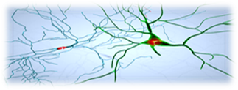
Our Outcomes following Cognitive Stimulation Interventions
Notes:
This young person had a stroke at age 10.
Learning difficulties emerged in secondary school and they received SEN support right through school.
He was diagnosed as having a low IQ and low academic ability.
He has been in and out of CAMHS for treatment – treatments made no difference.
The blue bars indicate where he was cognitively when he came to us.
The green indicates a year later – and after a year in college.
He passed his first year with a distinction in IT! In Year 2 – he has achieved Distinction, distinction and a Merit.
He is now moving on to Higher education. His confidence has improved, his self-esteem is much improved.
He said – since working with us, things are much better for him. The work we do makes it easier for him t learn and he gets things much quicker.

Slide 13
Our Outcomes following Cognitve Stimulation Interventions
Notes:
This young person had a concussion at age 3 at falling off a wall onto concrete.
Learning difficulties emerged in primary school and continued right through secondary school and into college. She was diagnosed as having a low IQ and low academic ability.
She has been in and out of CAMHS – no differences made or appropriate treatment given.
There was no consistency with her diagnosis – learning disability / learning difficulty.
She was failed at school and by the local authority – and failed under the Children Act.
Her education and formative years have been a traumatic experience.
When she first came to us, she cried uncontrollably when she thought about school.
When we assessed her – it was clear that she didn’t have a low IQ by the way she handled a laptop and complete the online assessment.
She improved her cognitive skills, her confidence and her self-esteem.

Slide 14
Our Outcomes following Cognitive Stimulation Interventions
Notes:
This young person had five head injuries from falls and impact injuries to the head.
As they progressed through primary school they were falling more and more behind.
Alarms bells rang at home and at school when in year 6 they scored 1 / 30 in a test.
They developed poor self-confidence and low self esteem and had poor physical and psychological health.
The blue bar represents where she was when she started with us.
The green represents the progress they made with us in 12 months
She is now coping better at secondary school and she can complete her homework with little help form her parents.

Slide 15
Our Outcomes

Slide 16
T: 01642 989116
E: jan@matrixneurological.org.uk
W: www.matrixneurological.org
Notes:
I

